Slide 1
Modeling of Telecommunication CDRs in a Time Series dataset
Analysis, Clustering & Forecasting
By,
Aruna Subbiah

Slide 2
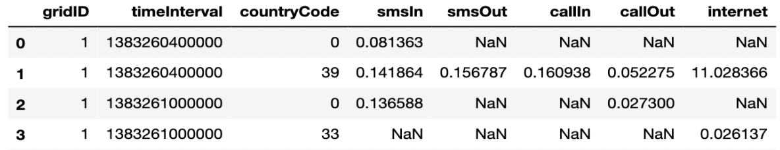
Call Detail Record
What is CDR?
describe a specific instance of a telecommunication transaction
Uses of CDR
billing purposes
settling accounts with other carriers
people's communication and mobility habits
Restricted availability of Telecommunication data for research

Slide 3
Dataset
Telecom Italia Big Data Challenge 2014
Telecommunications, weather, news, social networks and electricity data
City of Milan and the Province of Trentino
Open Database License (ODbL)
Harvard Dataverse
Telecom Italia, 2015, "Telecommunications - SMS, Call, Internet - MI", https://doi.org/10.7910/DVN/EGZHFV, Harvard Dataverse, V1
Notes:
Aggregation of telecommunications, weather, news, social networks and electricity data from the city of Milan and the Province of Trentino
Released to the research teams under the Open Database License (ODbL) and is maintained by Harvard Dataverse

Slide 4
Telecommunication Dataset - Milan
Industrial, commercial, and financial center of Italy
Telecom Italia’s network usage
Own customers & roaming
Telecommunication events recorded
received SMS, sent SMS, incoming Call, outgoing Call, Internet activity
from November 1st, 2013 to January 1st, 2014
temporal aggregation of time slots of ten minutes
number of records in the datasets 𝑆′𝑖(𝑡) follows the rule:
𝑆′_{𝑖}(𝑡)=𝑆_{𝑖}(𝑡)𝑘
k is a constant defined by Telecom Italia
62 tab delimited .txt files , one file for a day
Barlacchi, G., De Nadai, M., Larcher, R. et al. A multi-source dataset of urban life in the city of Milan and the Province of Trentino. Sci Data 2, 150055 (2015). https://doi.org/10.1038/sdata.2015.55
Notes:
Every time a user engages a telecommunication interaction, a Radio Base Station (RBS) is assigned by the operator and delivers the communication through the network. Then, a new CDR is created recording the time of the interaction and the RBS which handled it.
Received SMS a CDR is generated each time a user receives an SMS
Sent SMS a CDR is generated each time a user sends an SMS
Incoming Call a CDR is generated each time a user receives a call
Outgoing Call a CDR is generated each time a user issues a call
Internet a CDR is generated each time a user starts an Internet connection
k is a constant defined by Telecom Italia, which hides the true number of calls, SMS and connections

Slide 5
Grids
Datasets from different sources with different geographical boundaries
Milan’s spatial distribution is aggregated in a grid with 10,000 square cells
Provides ease the comparisons of different geographical areas
Grid dataset milano-grid.geojson provides geographical reference of each square
Reference system: WGS84 (EPSG:4326)
Telecom Italia, 2015, "Milano Grid", https://doi.org/10.7910/DVN/QJWLFU, Harvard Dataverse, V1

Slide 6
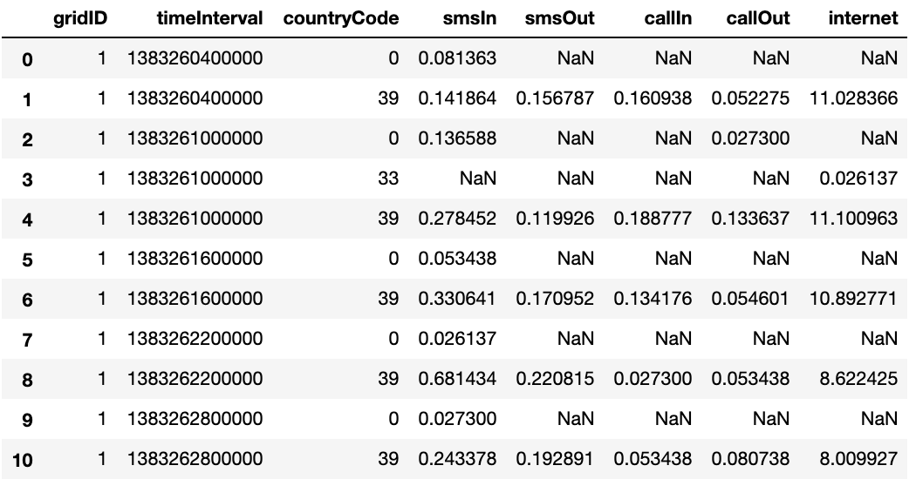
Data Wrangling
Reading data into Pandas DataFrame

Slide 7
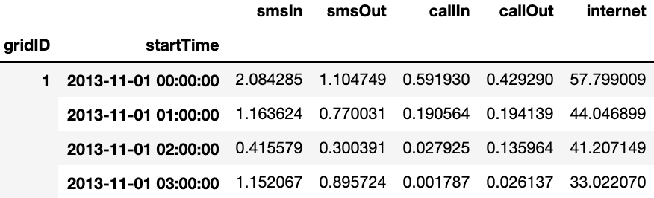
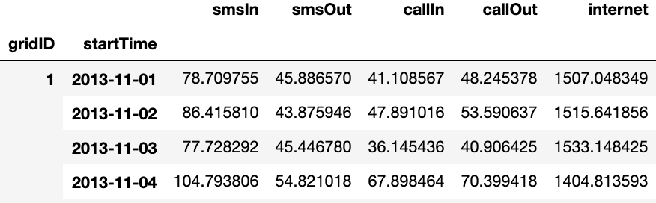
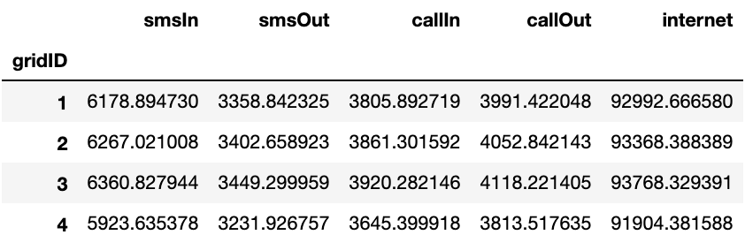
Handling Datetime
Epoch/Unix timestamps -> Datetime object -> Milan's local time zone
Resampling
Hourly Aggregation indexed by grid
Daily Aggregation indexed by grid
Total volumes over two months indexed by grid

Slide 8
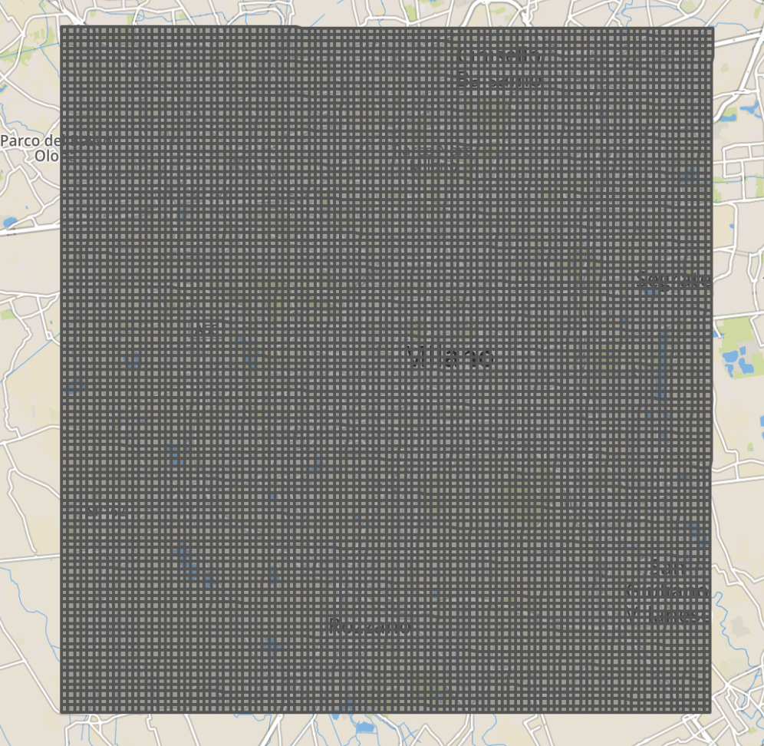
Exploratory Data Analysis
Geographic visualization of grids using geopandas and geojsonio

Slide 9
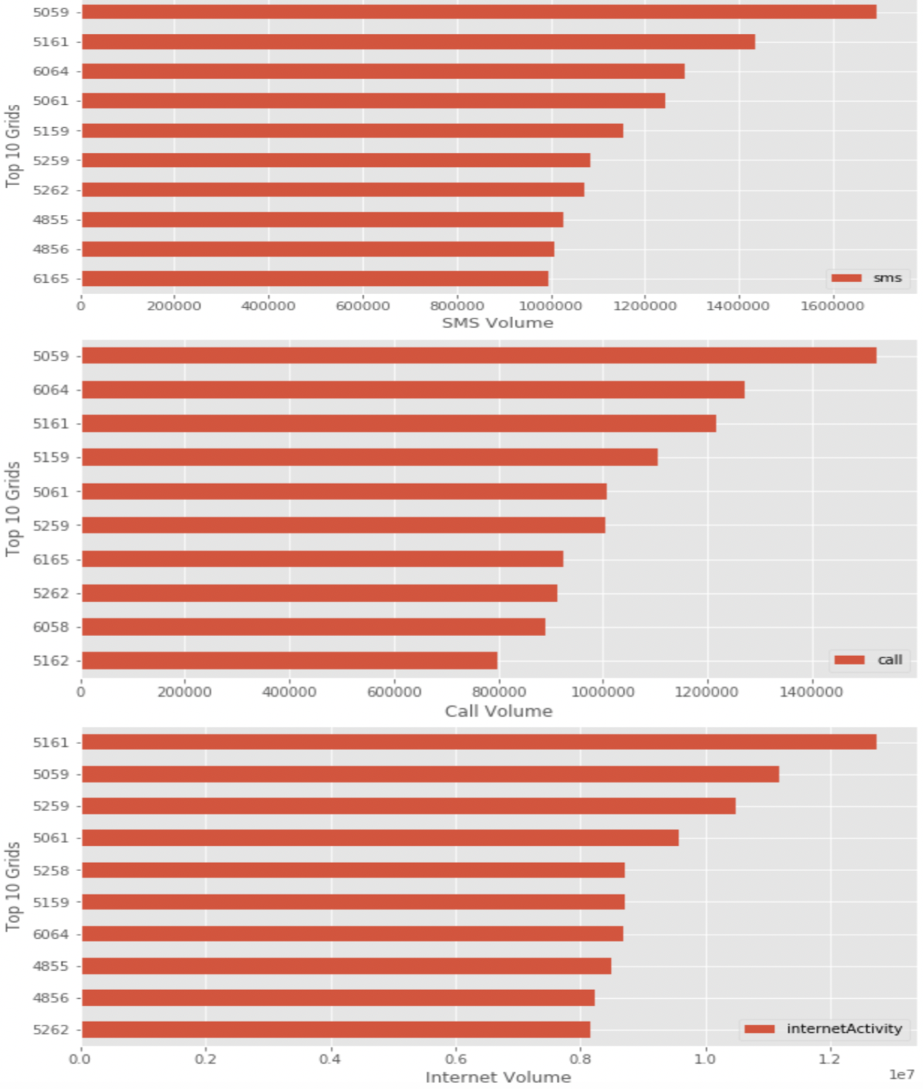
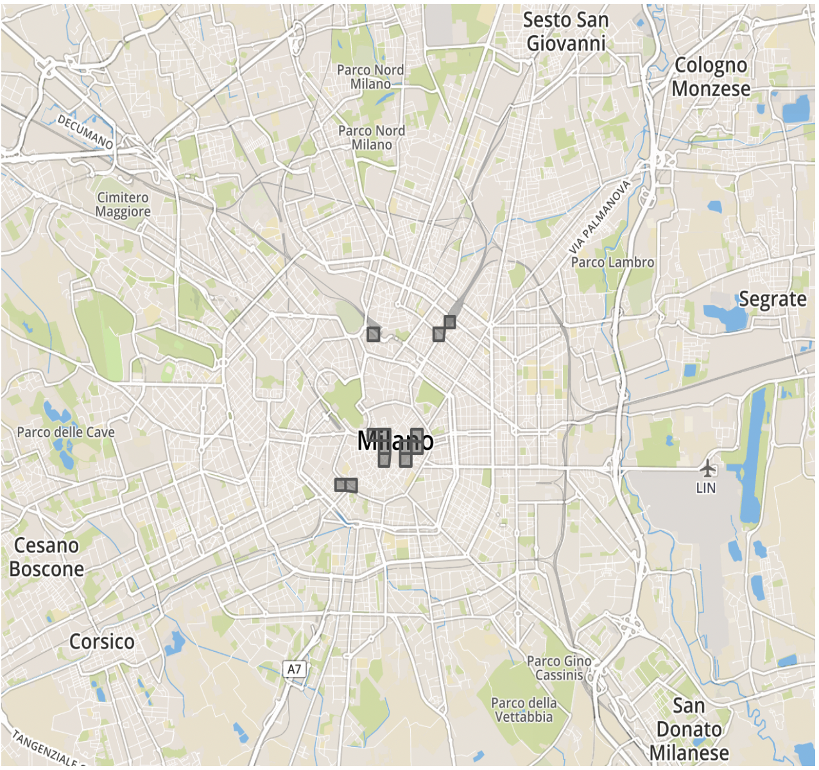
Top 10 Grids
SMS = SMS In + SMS Out [Control channel ]
Call = Call In + Call Out [Voice Channel]

Slide 10
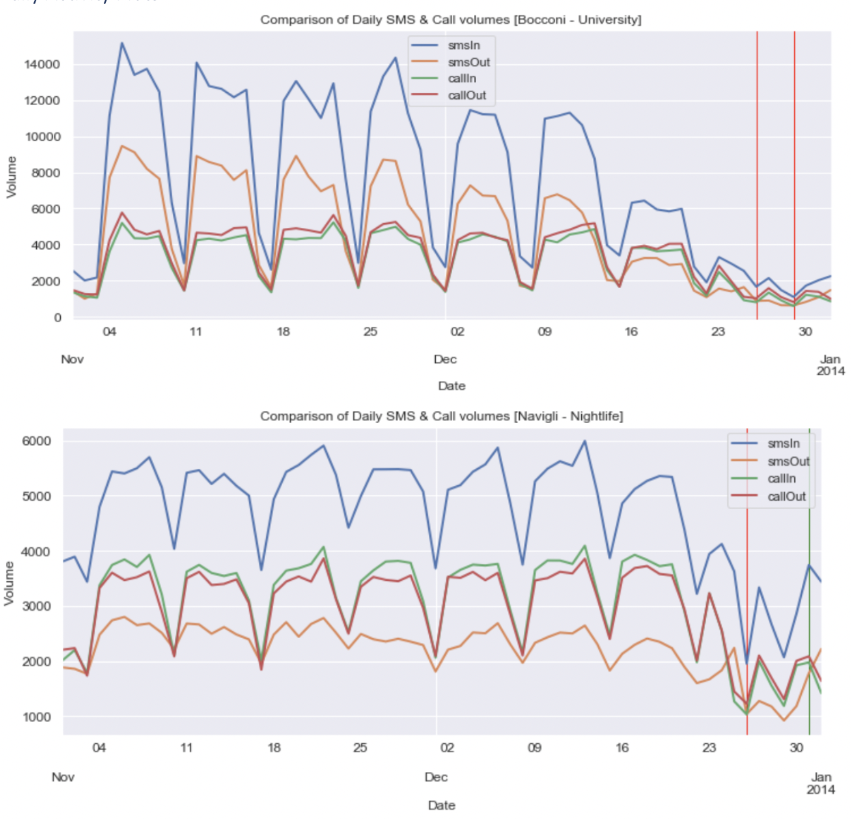
Activity pattern in different regions 4459 - Bocconi, one of the most famous Universities in Milan 4456 - Navigli, one of the most famous nightlife places in Milan 5060 - Duomo, the city center of Milan 5646 - Fiera, residential neighborhood of Milan
Daily Activity Plots

Slide 11
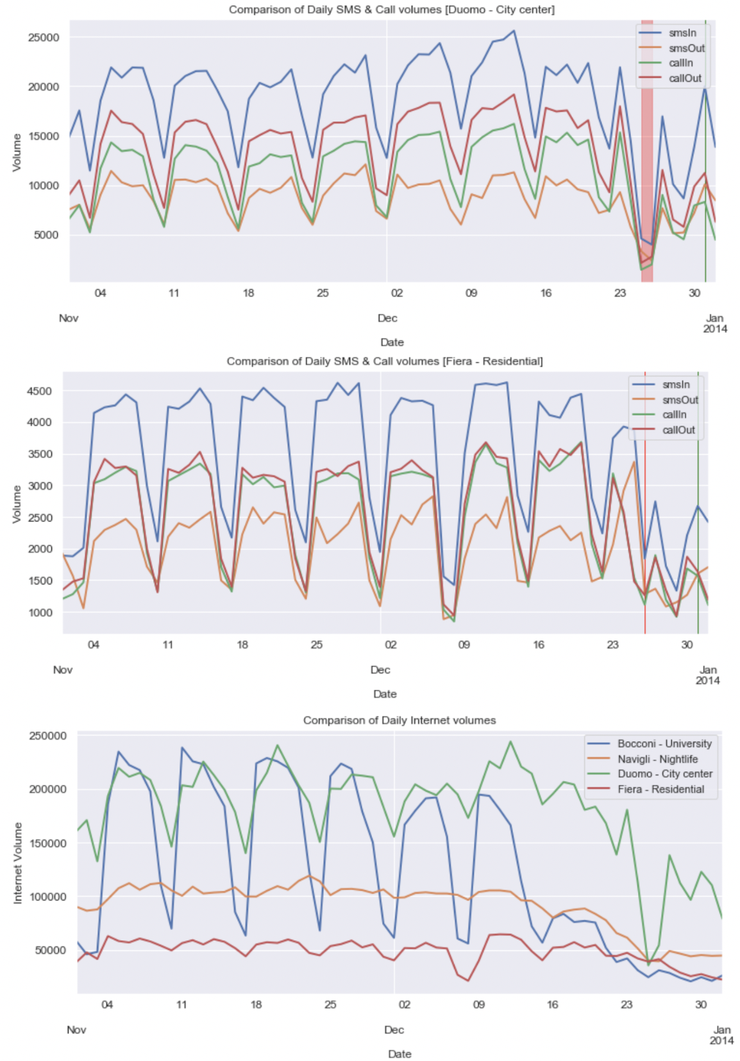
high volumes of incoming SMS
net volume generated,
Duomo [city center] > Bocconi [university] > Navigli [nightlife] > Fiera [residential]
seasonality in SMS & Call activities
Navigli & Fiera, no seasonality in Internet activity [IoT?? Or people mobility?]

Slide 12
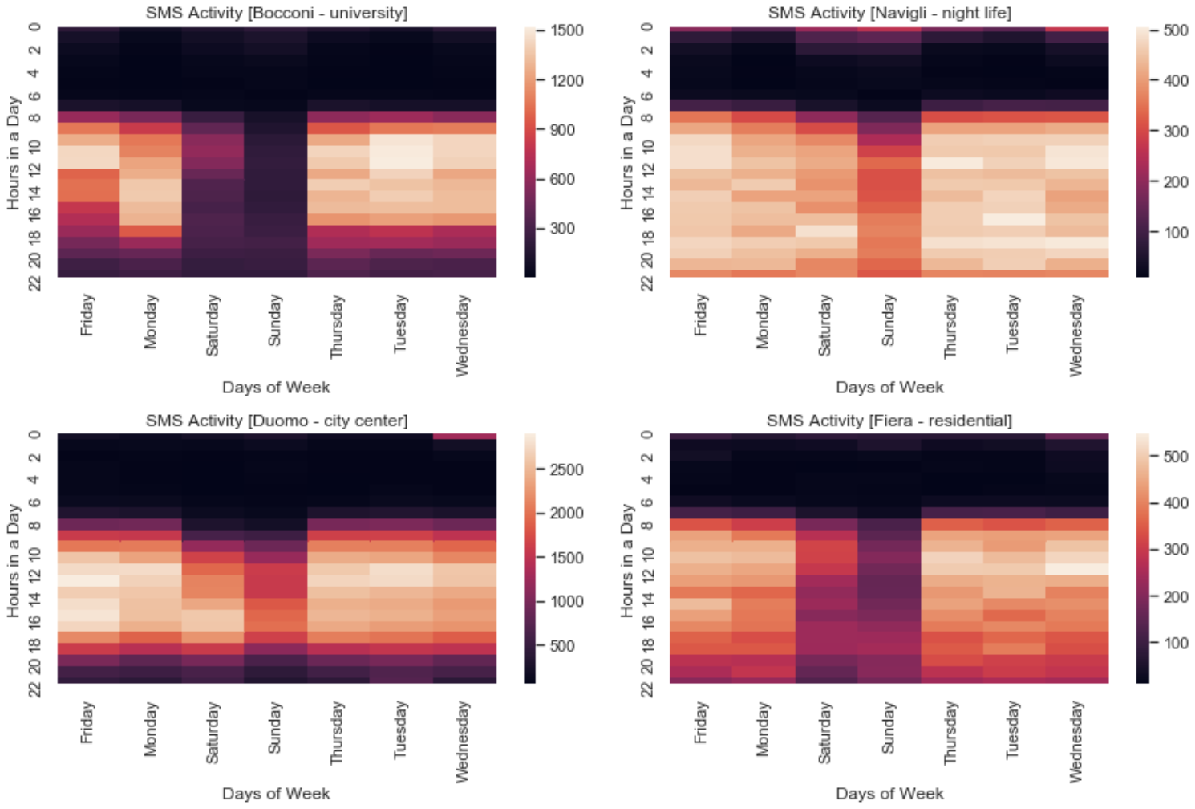
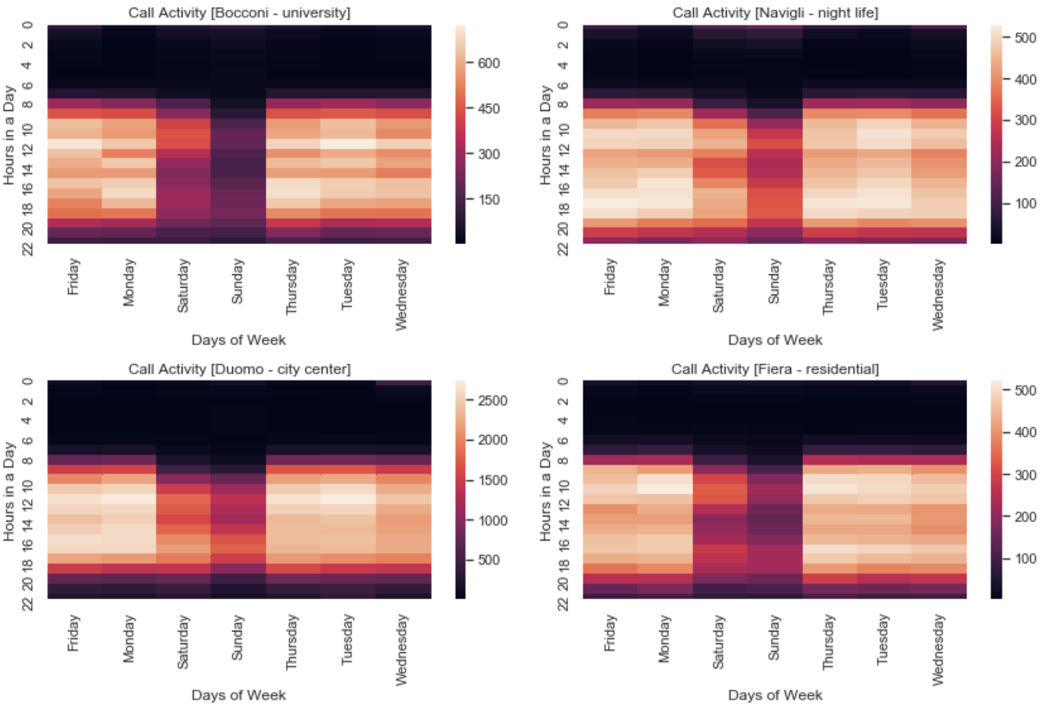
Hourly Activity Plots
SMS & Call Activity
less activities during the weekends
Fiera & Navigli regions are very active from 7am till 10pm on all days
Navigli, Duomo & Fiera shows a bright region on Wednesday 12am [New Year Eve??]
Bocconi and Duomo shows distinct dark and bright regions, may be due to people’s mobility pattern

Slide 13
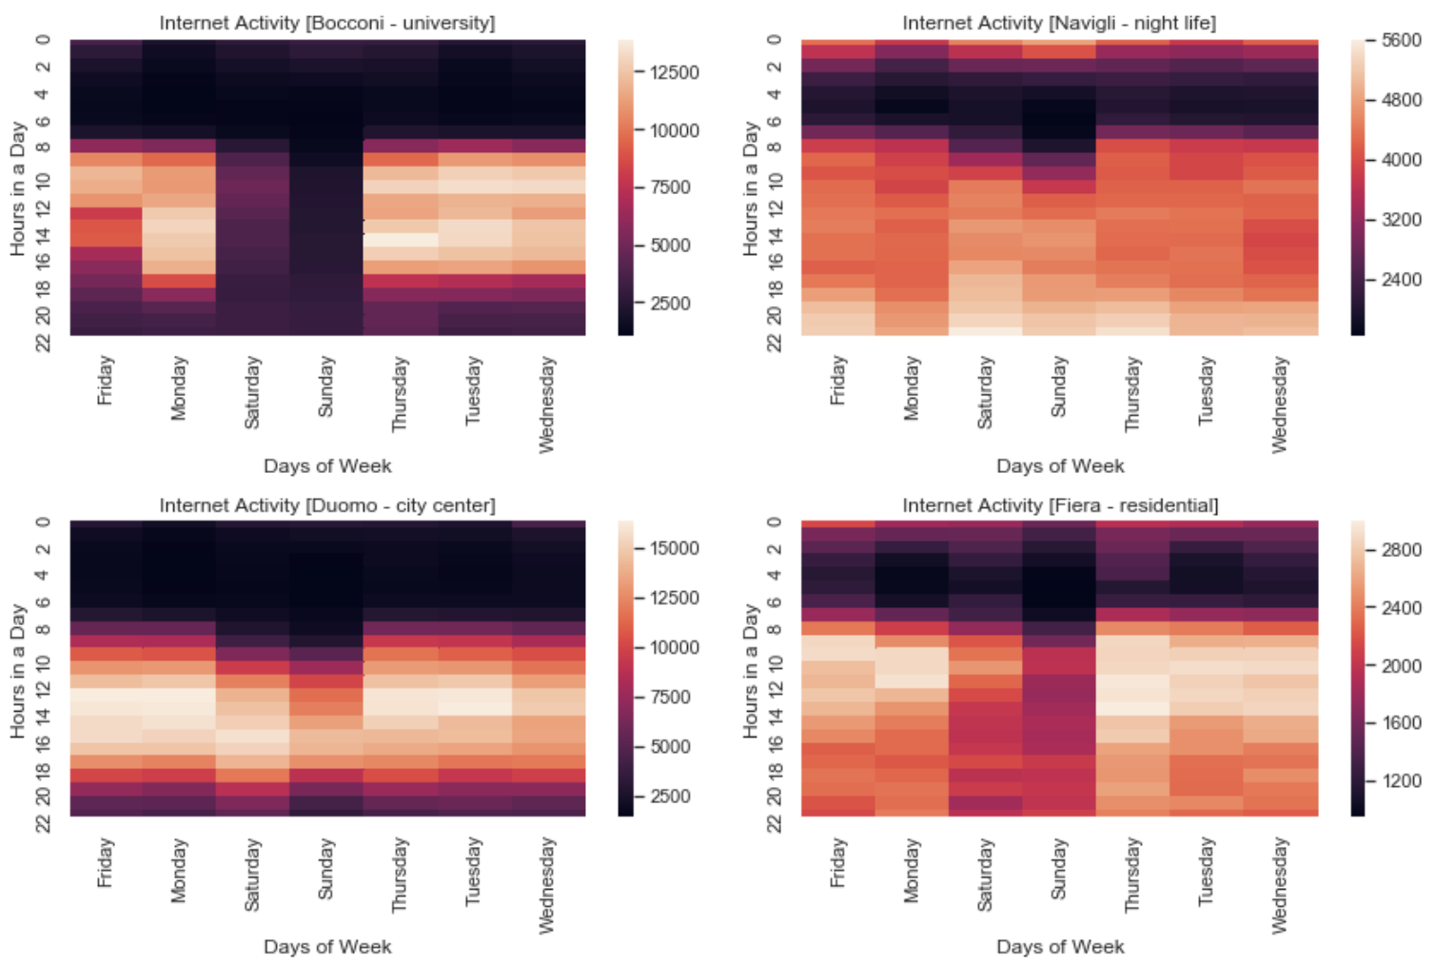
Internet Activity
Navigli & Fiera has internet activities almost all through the night
Bocconi shows some sparse activity after midnight on weekends
Duomo, city center although has the highest internet volumes
8am – 10pm on weekdays and 10am to 10pm on weekends

Slide 14
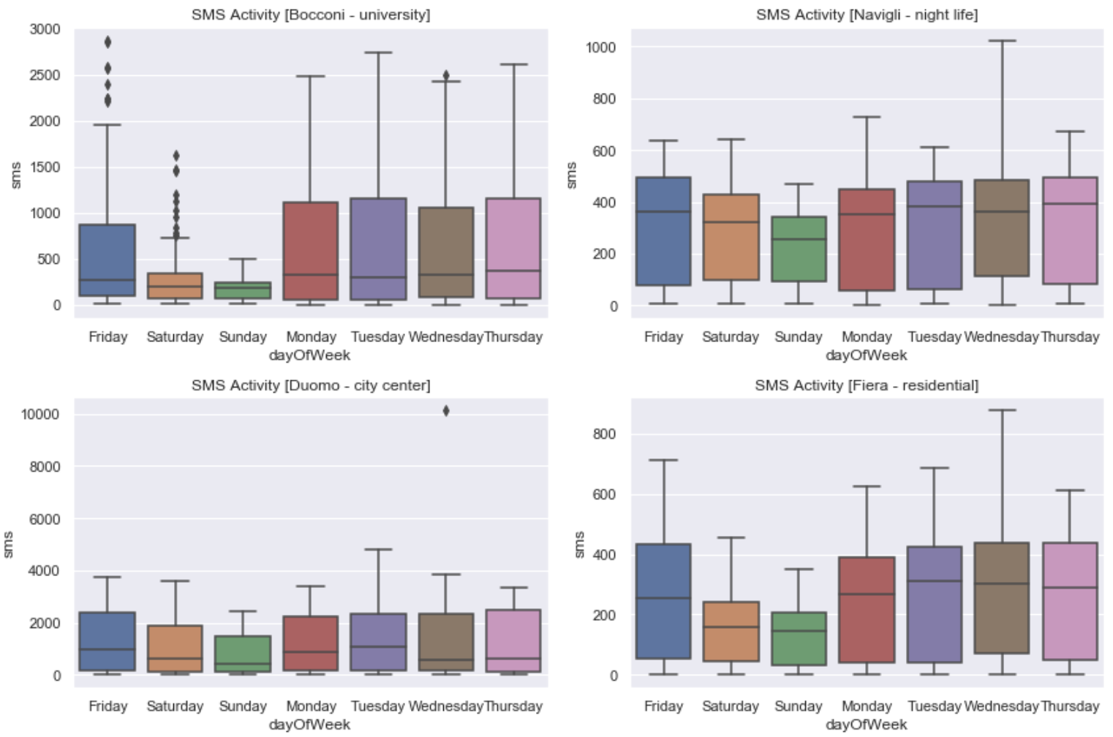
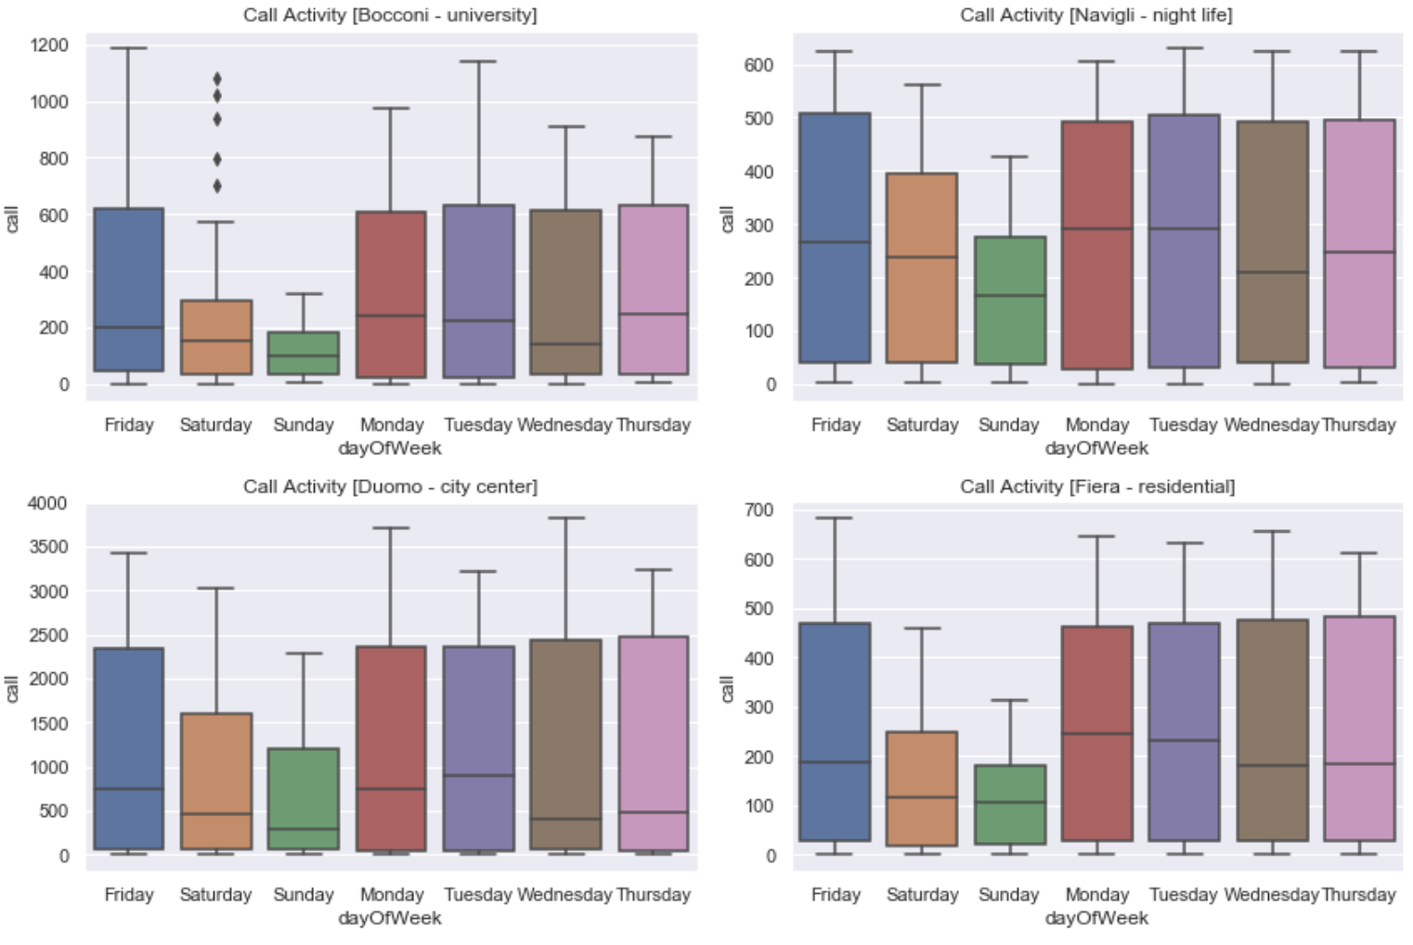
Day of Week Plots
SMS & Call Activity
Bocconi has outliers on Friday & Saturday
Least volumes of SMS & Calls on Sunday

Slide 15
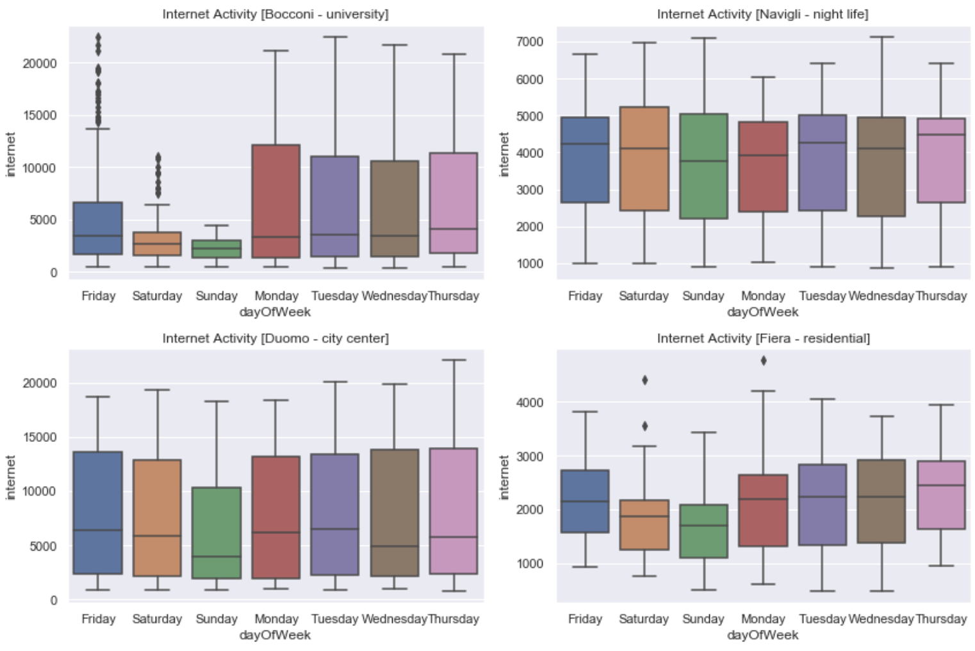
Internet Activity
Steady volume of Internet in Navigli
Outliers on Friday & Saturday in Bocconi
Both Duomo & Bocconi have utilized high volumes of Internet

Slide 16
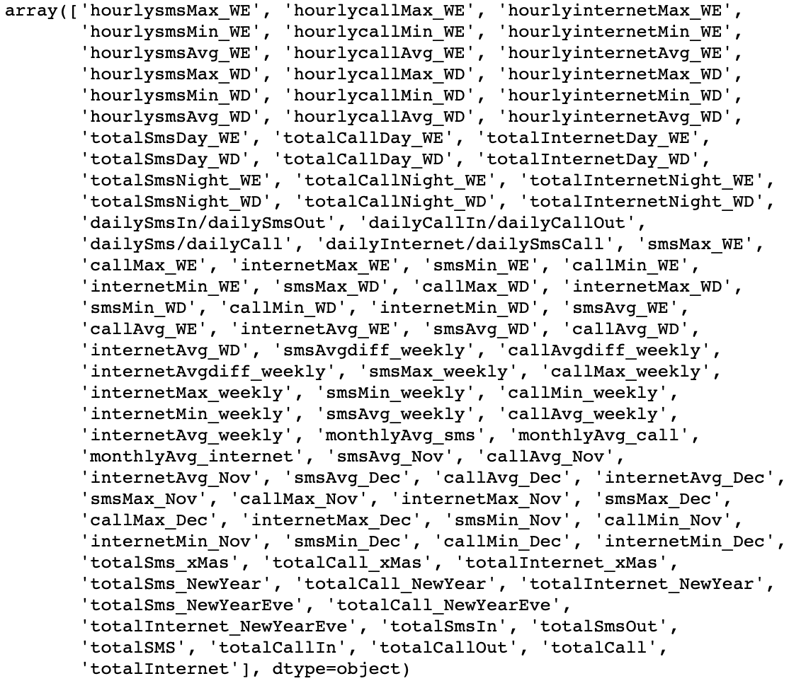
Feature Engineering
Feature Engineering is extracting more information from the existing data

Slide 17
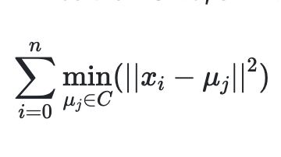
Modeling: K-Means Clustering
sklearn.cluster.KMeans
aims to choose centroids that minimize the inertia, or within-cluster sum-of-squares criterion
number of clusters to be specified
https://scikit-learn.org/stable/modules/generated/sklearn.cluster.KMeans.html

Slide 18
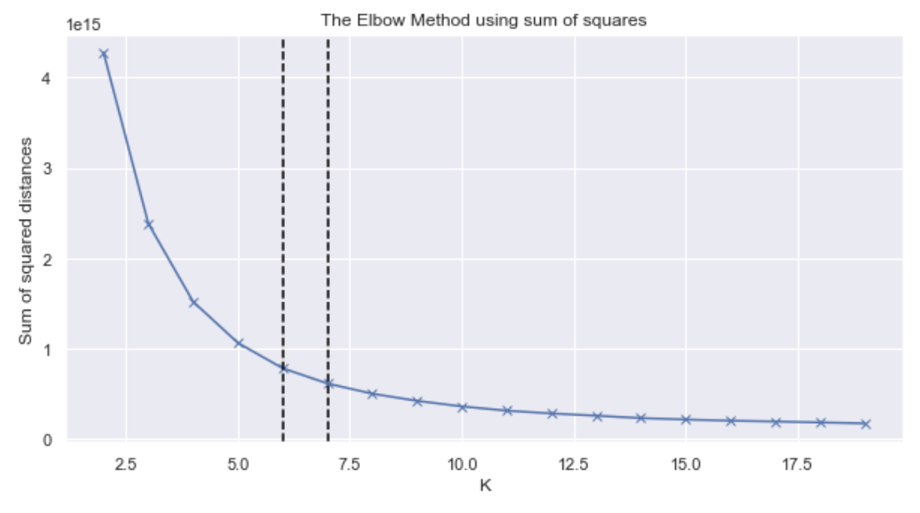
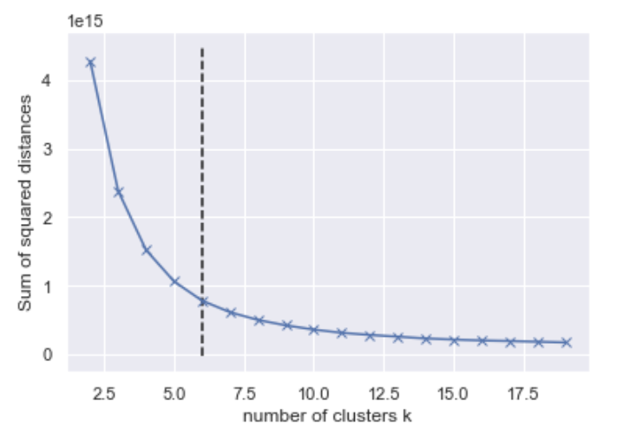
Optimal K value
Elbow Method
Smooth Elbow
K = 6 or K =7 after which curve plateaus
Kneed Package
Visual inspection can be tricky
Mathematically computes the Elbow point
K = 6

Slide 19
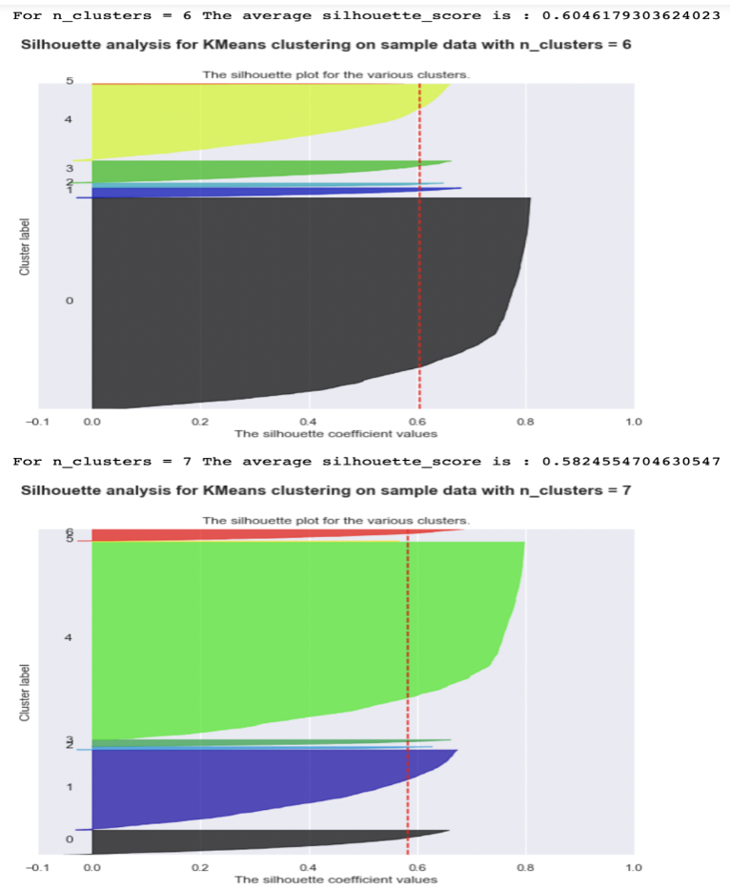
Silhouette coefficient plot
a measure of how close each point in one cluster is to points in the neighboring clusters
+1 , sample is far away from the neighboring clusters.
0 , sample is on or very close to the decision boundary
negative values, samples assigned to the wrong cluster.

Slide 20
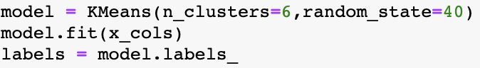
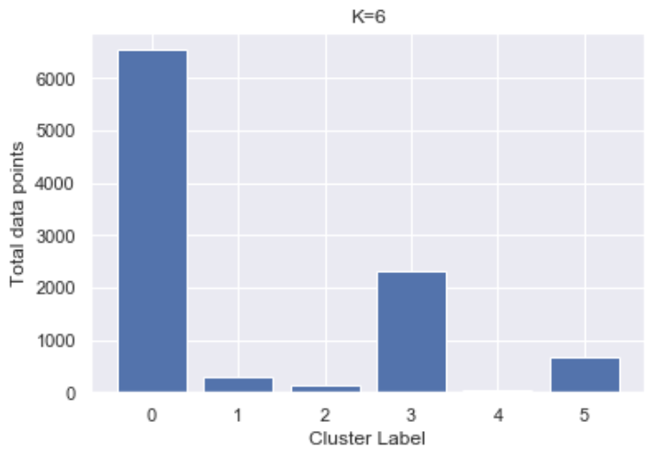
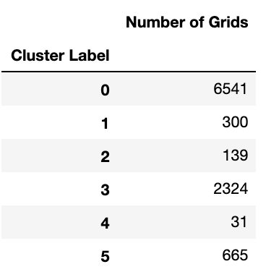
K-Means Clustering [ K=6]
x_cols : numpy array of all the features

Slide 21
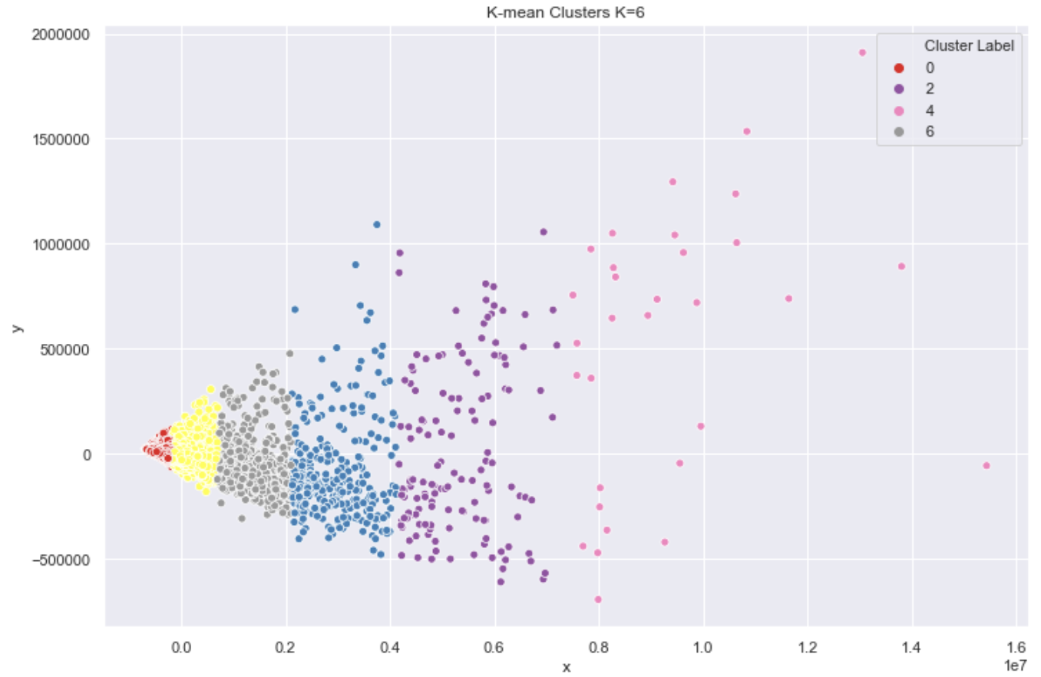
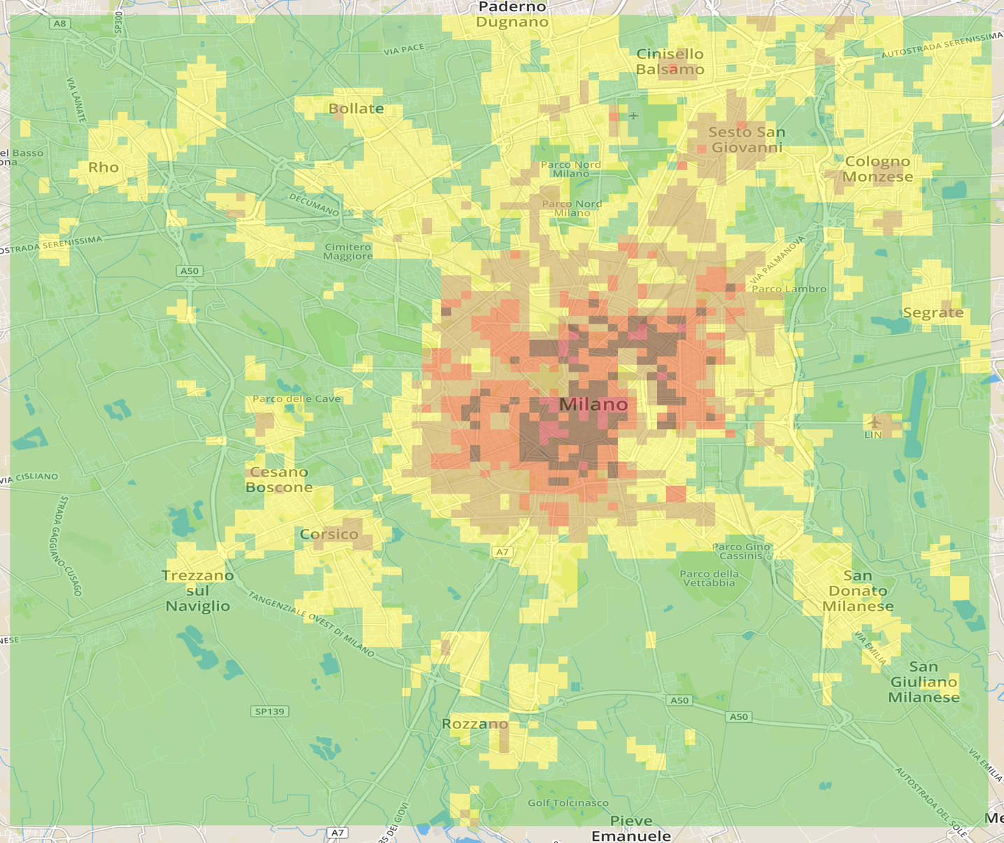
Visualization of Clusters

Slide 22
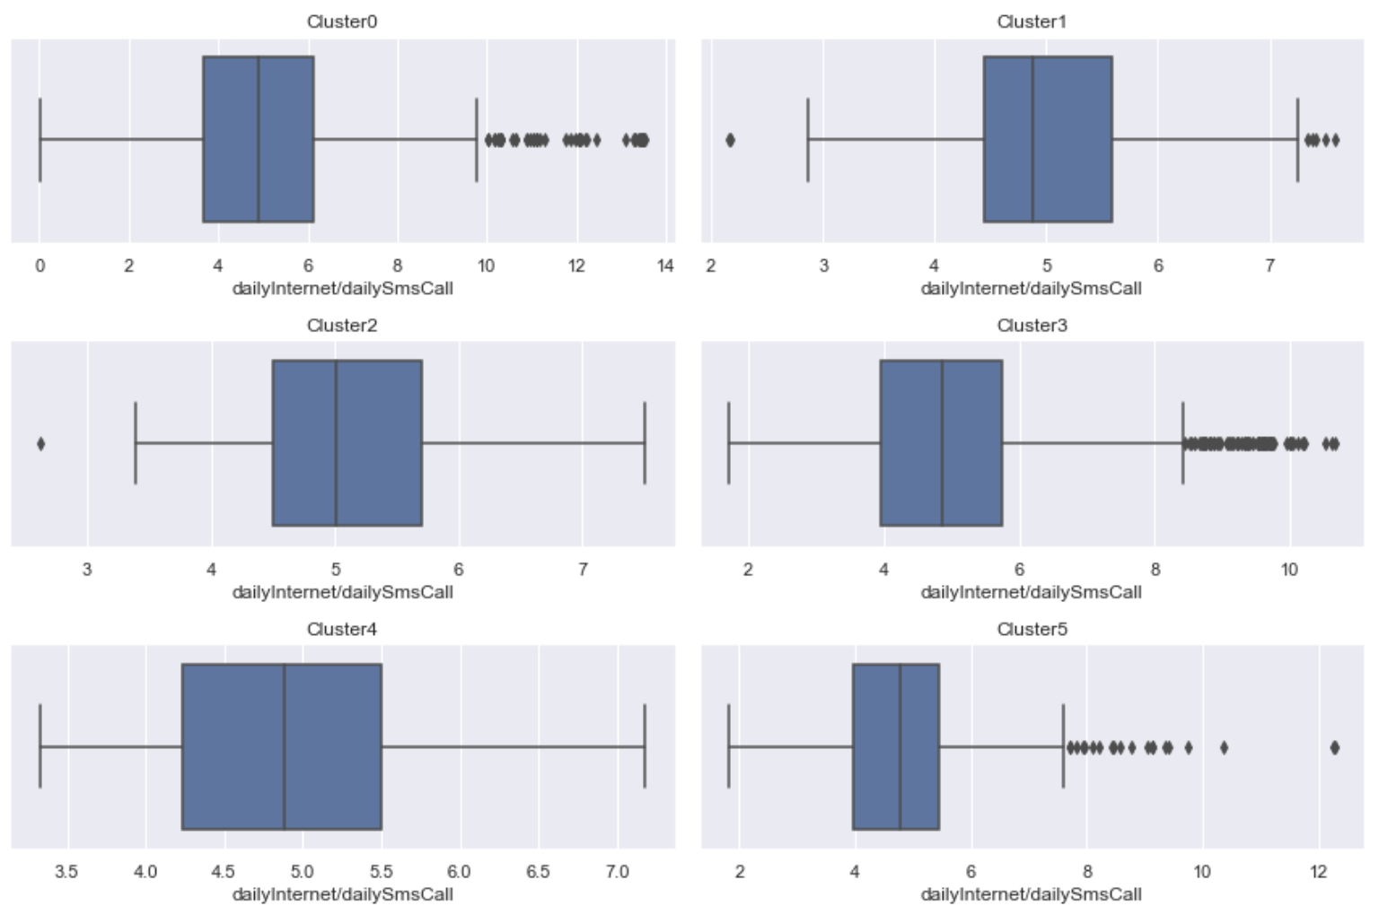
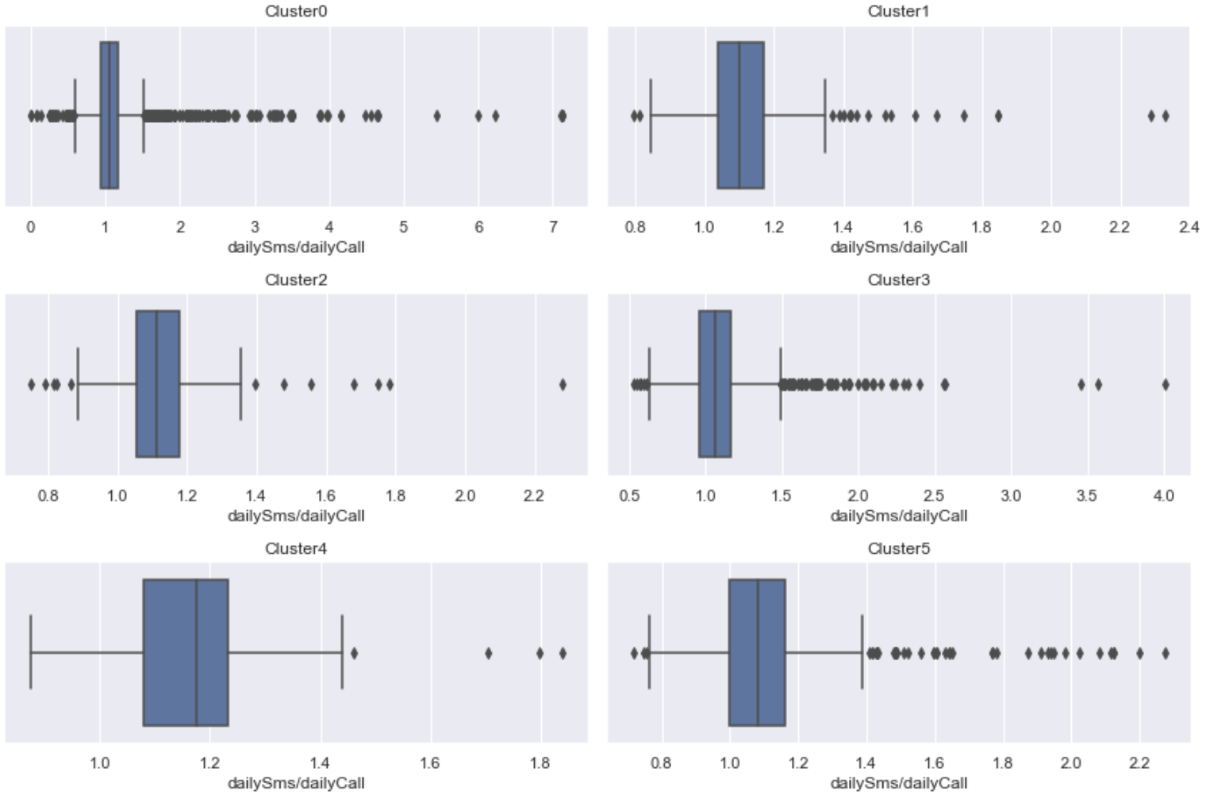
Analysis of the Clusters

Slide 23
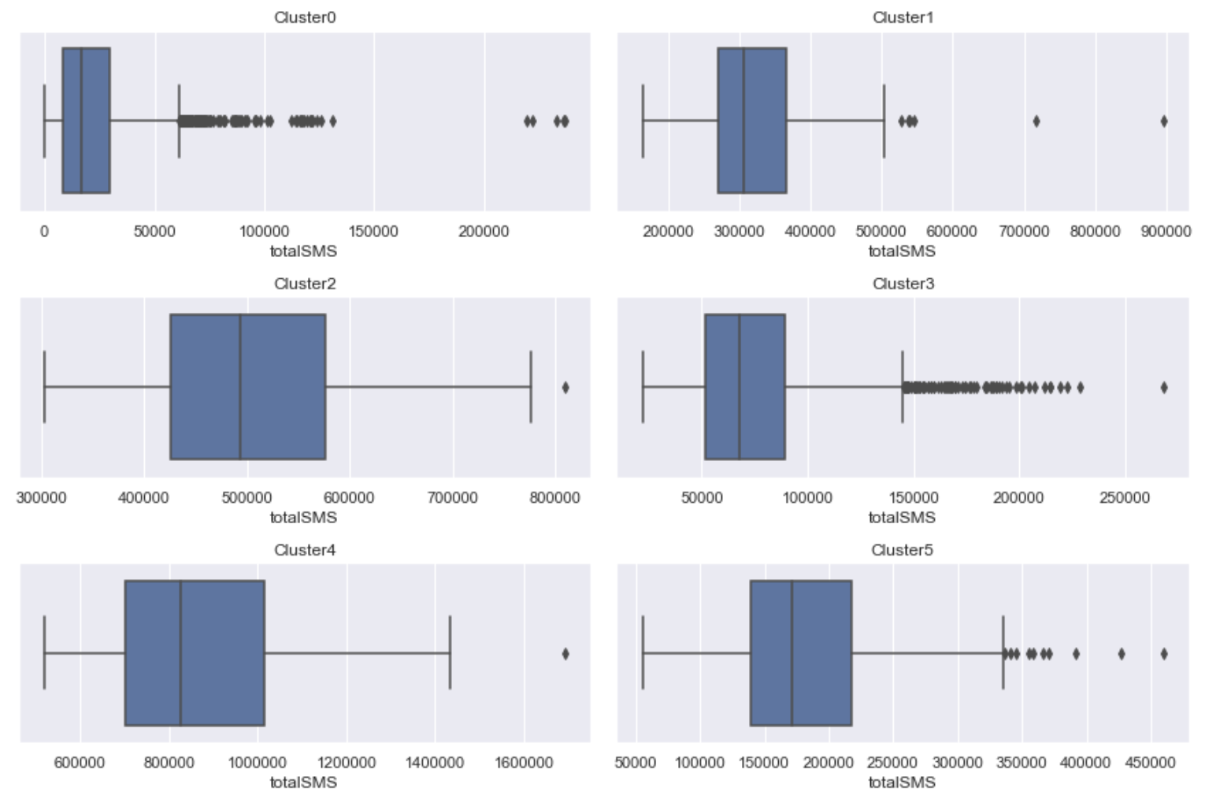
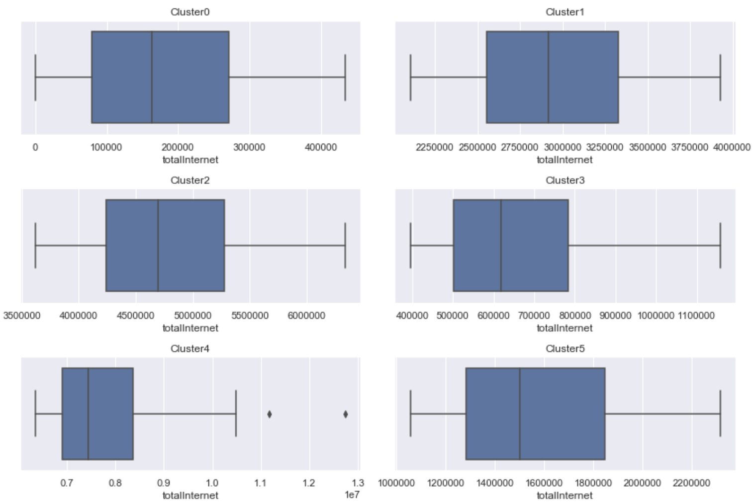
Analysis of the Clusters

Slide 24
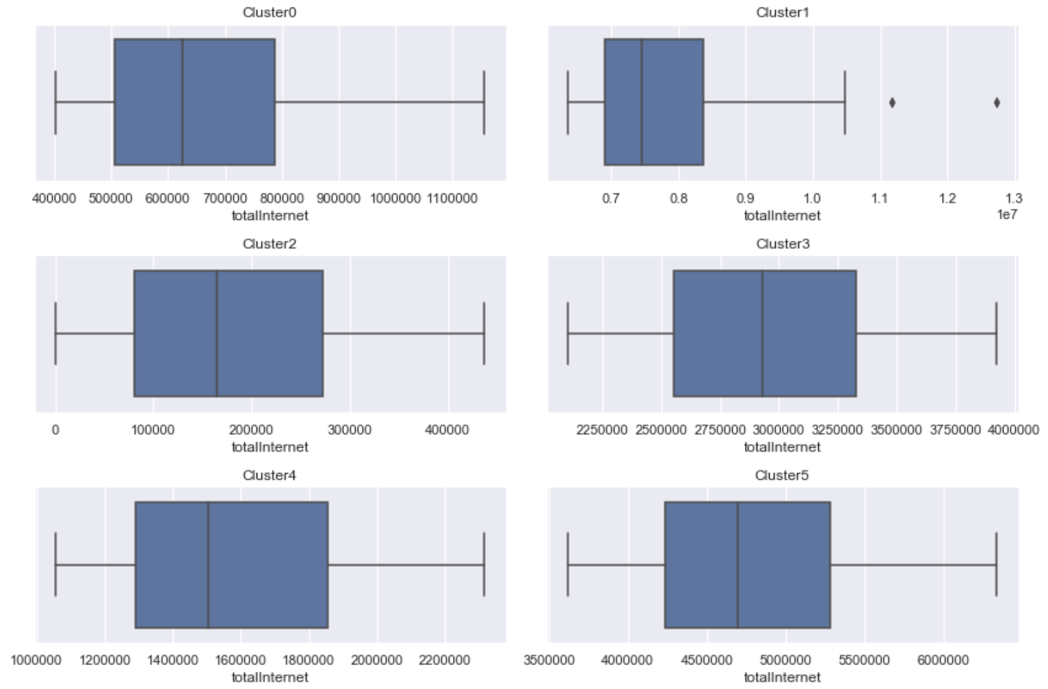
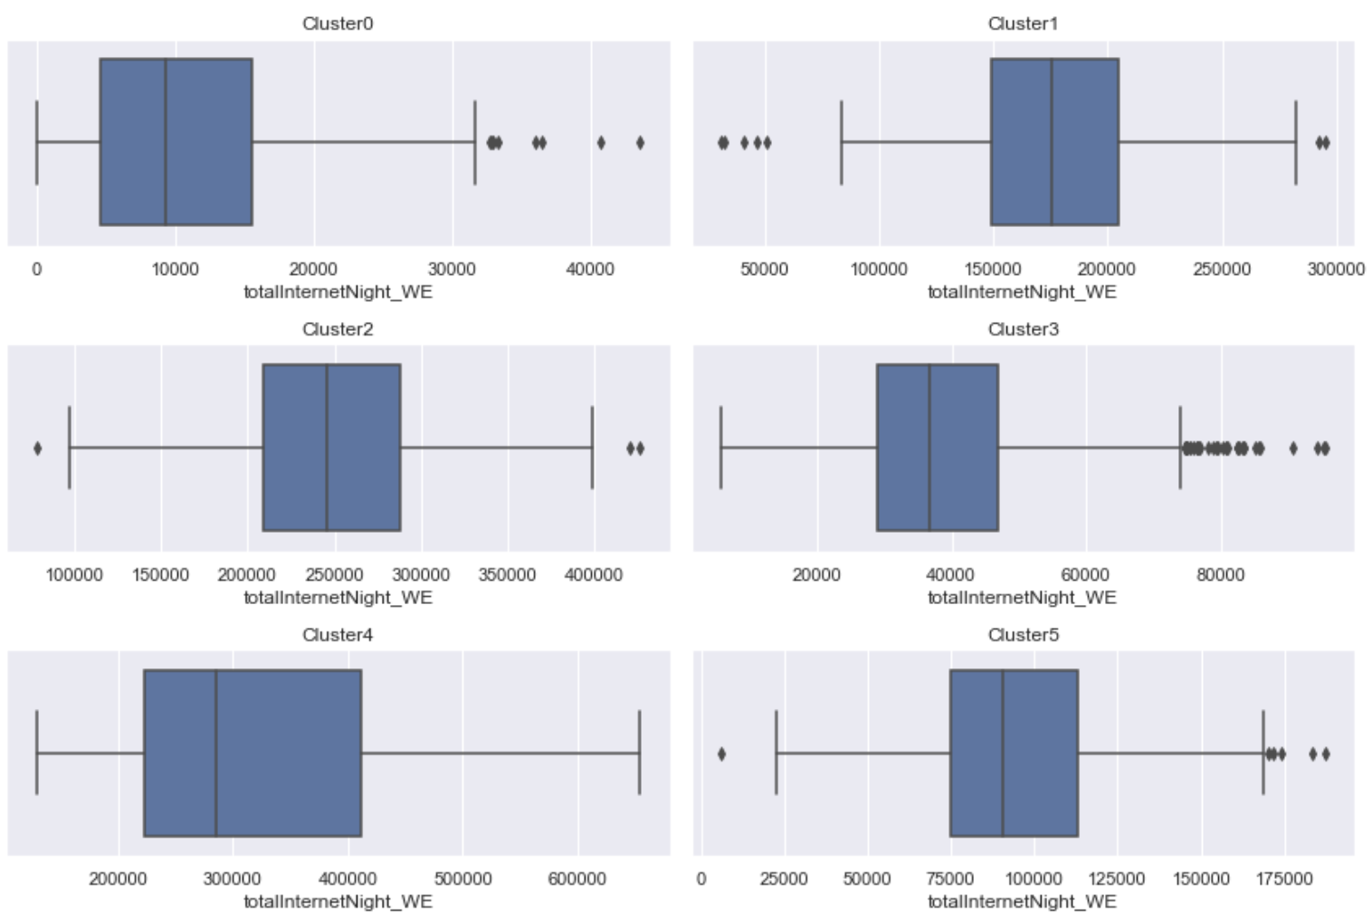
Analysis of the Clusters

Slide 25
THANK YOU

